Slide 1
DWDM
Unit 1

Slide 2
What is Data Warehouse?
Defined in many different ways, but not rigorously.
A decision support database that is maintained separately from the organization’s operational database
Support information processing by providing a solid platform of consolidated, historical data for analysis.
“A data warehouse is a subject-oriented, integrated, time-variant, and nonvolatile collection of data in support of management’s decision-making process.”—W. H. Inmon

Slide 3
Data Warehouse—Subject-Oriented
Organized around major subjects, such as customer, product, sales
Focusing on the modeling and analysis of data for decision makers, not on daily operations or transaction processing
Provide a simple and concise view around particular subject issues by excluding data that are not useful in the decision support process

Slide 4
Data Warehouse—Integrated
Constructed by integrating multiple, heterogeneous data sources
relational databases, flat files, on-line transaction records
Data cleaning and data integration techniques are applied.
Ensure consistency in naming conventions, encoding structures, attribute measures, etc. among different data sources
E.g., Hotel price: currency, tax, breakfast covered, etc.
When data is moved to the warehouse, it is converted.

Slide 5
Data Warehouse—Time Variant
The time horizon for the data warehouse is significantly longer than that of operational systems
Operational database: current value data
Data warehouse data: provide information from a historical perspective (e.g., past 5-10 years)
Every key structure in the data warehouse
Contains an element of time, explicitly or implicitly
But the key of operational data may or may not contain “time element”

Slide 6
Data Warehouse—Nonvolatile
A physically separate store of data transformed from the operational environment
Operational update of data does not occur in the data warehouse environment
Does not require transaction processing, recovery, and concurrency control mechanisms
Requires only two operations in data accessing:
initial loading of data and access of data

Slide 7
Functions of Data Warehousing
Data Extraction - Involves gathering data from multiple heterogeneous sources.
Data Cleaning - Involves finding and correcting the errors in data.
Data Transformation - Involves converting the data from legacy format to warehouse format.
Data Loading - Involves sorting, summarizing, consolidating, checking integrity, and building indices and partitions.
Refreshing - Involves updating from data sources to warehouse.

Slide 8
DBMS vs. Data Warehouse
DBMS: (OLTP : Online Transaction Processing)
Query driven i.e.
Build wrappers/mediators on top of heterogeneous databases
When a query is posed to a client site, a meta-dictionary is used to translate the query into queries appropriate for individual heterogeneous sites involved, and the results are integrated into a global answer set
OLTP i.e.
Focuses on day to day operation of an organization such as purchasing, inventory, manufacturing, banking, payroll, registration, and accounting.

Slide 9
DBMS vs. Data Warehouse…
Data Warehouse: (OLAP: Online Analytical Processing)
Update driven i.e.
Information from heterogeneous sources is integrated in advance and stored in warehouses for direct query and analysis
Such systems can organize and present data in various formats in order to accommodate the diverse needs of the different users.
OLAP i.e.
serve users or knowledge workers in the role of data analysis and decision making.

Slide 10
DBMS vs. Data Warehouse…

Slide 11
Why Separate Data Warehouse?
High performance for both systems
DBMS— tuned for OLTP: access methods, indexing, concurrency control, recovery
Warehouse—tuned for OLAP: complex OLAP queries, multidimensional view, consolidation
Different functions and different data:
Missing data: Decision support requires historical data which operational DBs do not typically maintain
Data consolidation: DS requires consolidation (aggregation, summarization) of data from heterogeneous sources
Data quality: different sources typically use inconsistent data representations, codes and formats which have to be reconciled
Note: There are more and more systems which perform OLAP analysis directly on relational databases

Slide 12
Schemas for Multidimensional Database
Schema is a logical description of the entire database. It includes the name and description of records of all record types including all associated data-items and aggregates.
A data warehouse uses
Star
Snowflake and
Fact Constellation schema.

Slide 13
Schemas for Multidimensional Database…
Star schema: A fact table in the middle connected to a set of dimension tables
Snowflake schema: A refinement of star schema where some dimensional hierarchy is normalized into a set of smaller dimension tables, forming a shape similar to snowflake
Fact constellations: Multiple fact tables share dimension tables, viewed as a collection of stars, therefore called galaxy schema or fact constellation

Slide 14
Schemas for Multidimensional Database…
Star Schema:
It is the data warehouse schema that contains two types of tables: Fact Table and Dimension Tables. Fact Table lies at the center point and dimension tables are connected with fact table such that star shape is formed.
Fact Tables: A fact table typically has two types of columns: foreign keys to dimension tables and measures those that contain numeric facts. A fact table can contain data on detail or aggregated level.
Dimension Tables: Dimension tables usually have a relatively small number of records compared to fact tables, but each record may have a very large number of attributes to describe the fact data.

Slide 15
Figure: Example of Star Schema
Schemas for Multidimensional Database…
time
time_key
day
day_of_the_week
month
quarter
year
item
item_key
item_name
brand
type
supplier_type
Sales Fact Table
time_key
item_key
branch_key
branch
location
location_key
branch_key
branch_name
branch_type
location_key
street
city
state_or_province
country
units_sold
dollars_sold
avg_sales
Measures

Slide 16
Schemas for Multidimensional Database…
Each dimension in the star schema has only one dimension table and each table holds a set of attributes. This constraint may cause data redundancy. The following diagram shows the sales data of a company with respect to the four dimensions, namely time, item, branch, and location.
There is a fact table at the center. It contains the keys to each of four dimensions. The fact table also contains the attributes, namely dollars sold and units sold.
Since star schema contains de-normalized dimension tables, it leads to simpler queries due to lesser number of join operations and it also leads to better system performance. On the other hand it is difficult to maintain integrity of data in star schema due to de-normalized tables. It is the widely used data warehouse schema and is also recommended by oracle

Slide 17
Schemas for Multidimensional Database…
Snowflake Schema
The snowflake schema is a variant of the star schema model, where some dimension tables are normalized, thereby further splitting the data into additional tables.
The resulting schema graph forms a shape similar to a snowflake.
For example, the item dimension table in star schema is normalized and split into two dimension tables, namely item and supplier table.

Slide 18
Figure: Example of Snowflake Schema
Schemas for Multidimensional Database…
time
item
time_key
day
day_of_the_week
month
quarter
year
item_key
item_name
brand
type
supplier_key
supplier
Sales Fact Table
supplier_key
supplier_type
time_key
item_key
branch_key
branch
location
location_key
location_key
street
city_key
branch_key
branch_name
branch_type
units_sold
dollars_sold
city
city_key
city
state_or_province
country
avg_sales
Measures

Slide 19
Schemas for Multidimensional Database…
Due to normalization table is easy to maintain and saves storage space. However, this saving of space is negligible in comparison to the typical magnitude of the fact table.
Furthermore, the snowflake structure can reduce the effectiveness of browsing, since more joins will be needed to execute a query.
Consequently, the system performance may be adversely impacted.
Hence, although the snowflake schema reduces redundancy, it is not as popular as the star schema in data warehouse design.

Slide 20
Schemas for Multidimensional Database…
Fact Constellation Schema
This kind of schema can be viewed as a collection of stars, and hence is called a galaxy schema or a fact constellation.
A fact constellation schema allows dimension tables to be shared between fact tables.
For example, following schema specifies two fact tables, sales and shipping. The sales table definition is identical to that of the star schema. The shipping table has five dimensions, or keys: item key, time key, shipper key, from location, and to location, and two measures: dollars cost and units shipped.

Slide 21
Figure: Example of Fact Constellation
Schemas for Multidimensional Database…
time
time_key
day
day_of_the_week
month
quarter
year
item
Shipping Fact Table
item_key
item_name
brand
type
supplier_type
Sales Fact Table
time_key
time_key
item_key
shipper_key
item_key
branch_key
from_location
branch
location_key
location
to_location
branch_key
branch_name
branch_type
units_sold
location_key
street
city
province_or_state
country
dollars_cost
dollars_sold
units_shipped
avg_sales
shipper
Measures
shipper_key
shipper_name
location_key
shipper_type

Slide 22
Cube Definition Syntax (BNF) in DMQL
Cube Definition (Fact Table)
define cube <cube_name> [<dimension_list>]: <measure_list>
Dimension Definition (Dimension Table)
define dimension <dimension_name> as (<attribute_or_subdimension_list>)
Special Case (Shared Dimension Tables)
First time as “cube definition”
define dimension <dimension_name> as <dimension_name_first_time> in cube <cube_name_first_time>

Slide 23
Defining Star Schema in DMQL
define cube sales_star [time, item, branch, location]:
dollars_sold = sum(sales_in_dollars), avg_sales = avg(sales_in_dollars), units_sold = count(*)
define dimension time as (time_key, day, day_of_week, month, quarter, year)
define dimension item as (item_key, item_name, brand, type, supplier_type)
define dimension branch as (branch_key, branch_name, branch_type)
define dimension location as (location_key, street, city, province_or_state, country)

Slide 24
Defining Snowflake Schema in DMQL
define cube sales_snowflake [time, item, branch, location]:
dollars_sold = sum(sales_in_dollars), avg_sales = avg(sales_in_dollars), units_sold = count(*)
define dimension time as (time_key, day, day_of_week, month, quarter, year)
define dimension item as (item_key, item_name, brand, type, supplier(supplier_key, supplier_type))
define dimension branch as (branch_key, branch_name, branch_type)
define dimension location as (location_key, street, city(city_key, province_or_state, country))

Slide 25
Defining Fact Constellation in DMQL
define cube sales [time, item, branch, location]:
dollars_sold = sum(sales_in_dollars), avg_sales = avg(sales_in_dollars), units_sold = count(*)
define dimension time as (time_key, day, day_of_week, month, quarter, year)
define dimension item as (item_key, item_name, brand, type, supplier_type)
define dimension branch as (branch_key, branch_name, branch_type)
define dimension location as (location_key, street, city, province_or_state, country)

Slide 26
Defining Fact Constellation in DMQL
define cube shipping [time, item, shipper, from_location, to_location]:
dollar_cost = sum(cost_in_dollars), unit_shipped = count(*)
define dimension time as time in cube sales
define dimension item time as item in cube sales
define dimension shipper as (shipper_key, shipper_name, location as location in cube sales, shipper_type)
define dimension from_location as location in cube sales
define dimension to_location as location in cube sales

Slide 27
Measures of Data Cube: Three Categories
Distributive: if the result derived by applying the function to n aggregate values is the same as that derived by applying the function on all the data without partitioning
E.g., count(), sum(), min(), max()
Algebraic: if it can be computed by an algebraic function with M arguments (where M is a bounded integer), each of which is obtained by applying a distributive aggregate function
E.g., avg(), min_N(), standard_deviation()
Holistic: if there is no constant bound on the storage size needed to describe a subaggregate.
E.g., median(), mode(), rank()

Slide 28
Data Marts
A data mart is a subject-oriented archive that stores data and uses the retrieved set of information to assist and support the requirements involved within a particular business function or department.
Data marts exist within a single organizational data warehouse repository.
Data marts improve end-user response time by allowing users to have access to the specific type of data they need to view most often.

Slide 29
Data Marts…
A data mart is basically a condensed and more focused version of a data warehouse that reflects the regulations and process specifications of each business unit within an organization.
Each data mart is dedicated to a specific business function or region.
Different data marts can be used to obtain specific information for various enterprise departments, such as accounting, marketing, sales, etc.

Slide 30
Meta Data
Metadata is simply defined as data about data.
The data that is used to represent other data is known as metadata. For example, the index of a book serves as a metadata for the contents in the book.
In other words, we can say that metadata is the summarized data that leads us to detailed data. In terms of data warehouse, we can define metadata as follows.
Metadata is the road-map to a data warehouse.
Metadata in a data warehouse defines the warehouse objects.
Metadata acts as a directory. This directory helps the decision support system to locate the contents of a data warehouse.

Slide 31
Meta Data…
Metadata can be broadly categorized into three categories:
Business Metadata: It has the data ownership information, business definition, and changing policies.
Technical Metadata - It includes database system names, table and column names and sizes, data types and allowed values. Technical metadata also includes structural information such as primary and foreign key attributes and indices.
Operational Metadata - It includes currency of data and data lineage. Currency of data means whether the data is active, archived, or purged. Lineage of data means the history of data migrated and transformation applied on it.

Slide 32
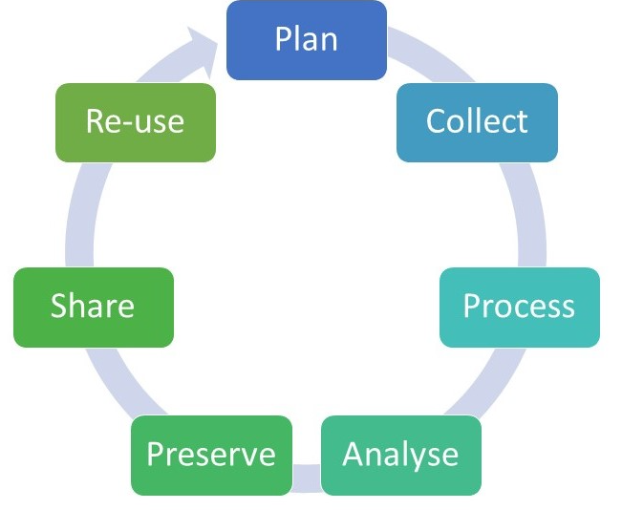
Lifecycle of data
Fig: The research data lifecycle

Slide 33
Lifecycle of data
The data life cycle is the sequence of stages that a particular unit of data goes through from its initial generation or capture to its eventual archival and/or deletion at the end of its useful life.
Plan: Identify the data that will be collected or used and plan for data management throughout the lifecycle.
Collect: This is the stage at which experiments are carried out, observations made, surveys undertaken, secondary materials acquired, etc.
Process: Data once collected will need to be processed in order to be usable.
Analysis: Data analysis is the stage at which the raw materials of research are interrogated to produce the insights that constitute the research findings, which will be written up and published in research outputs.

Slide 34
Lifecycle of data
Preserve: Result will preserve for the long term data that substantiate findings and have long-term value.
Share: Publications based on data should include a data citation or a statement indicating where and on what terms the data can be accessed.
Re-use: Data that are available for discovery and access may be re-used by other researchers, either to substantiate the findings of the original research, or to generate new insights through further interrogation and analysis.

Slide 35
Lifecycle of Data
The data life cycle is the sequence of stages that a particular unit of data goes through from its initial generation or capture to its eventual archival and/or deletion at the end of its useful life.
Data Life Cycle Management is a process that helps organizations to manage the flow of data throughout its lifecycle – from initial creation through to destruction.
While there are many interpretations as to the various phases of a typical data lifecycle, they can be summarized as follows:

Slide 36
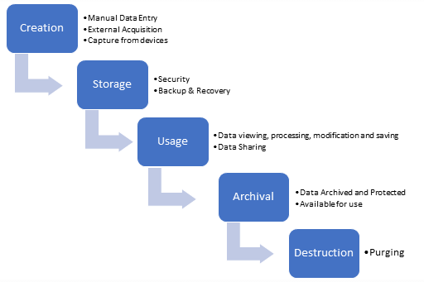
Lifecycle of Data

Slide 37
Lifecycle of Data
1. Data Creation
The first phase of the data lifecycle is the creation/capture of data. This data can be in many forms e.g. PDF, image, Word document, SQL database data. Data is typically created by an organization in one of 3 ways:
Data Acquisition: acquiring already existing data which has been produced outside the organization
Data Entry: manual entry of new data by personnel within the organization
Data Capture: capture of data generated by devices used in various processes in the organization

Slide 38
Lifecycle of Data
2. Storage
Once data has been created within the organization, it needs to be stored and protected, with the appropriate level of security.
A robust backup and recovery process should also be implemented to ensure retention of data during the lifecycle.
3.Usage
During the usage phase of the data lifecycle, data is used to support activities in the organization.
Data can be viewed, processed, modified and saved.
An audit trail should be maintained for all critical data to ensure that all modifications to data are fully traceable.
Data may also be made available to share with others outside the organization.

Slide 39
Lifecycle of Data
5. Archival
Data Archival is the copying of data to an environment where it is stored in case it is needed again in an active production environment
A data archive is simply a place where data is stored, but where no maintenance or general usage occurs.
If necessary, the data can be restored to an environment where it can be used.
6. Destruction
The volume of archived data inevitably grows, and while you may want to save all your data forever, that’s not feasible.
It is typically done from an archive storage location.
The challenge of this phase of the lifecycle is to ensure that the data has been properly destroyed.

Slide 40
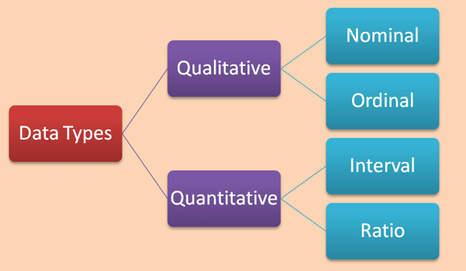
Types of Data
Basically, there are 2 classes of data in statistics that can be further sub-divided into 4 statistical data types.

Slide 41
Types of Data
Quantitative data is information about quantities of things, things that we measure, and so we describe them in terms of numbers. As such, quantitative data are also called Numerical data.
Qualitative data give us information about the qualities of things. They are observed phenomenon, not measured, and so we generally label them with names. Qualitative data are also known as Categorical data.

Slide 42
Types of Data
Nominal
Examples: Nationality (British, American, Spanish,...), Genre/Style (Rock, Hip-Hop, Jazz, Classical,...), Favourite colour (red, green, blue,...)
Ordinal
Examples: Opinion (agree, mostly agree, neutral, mostly disagree, disagree), Time of day (morning, noon, night)
Interval
Examples: Temperature (°C or F, but not Kelvin), Dates (1066, 1492, 1776, etc.), Time interval on a 12 hour clock (6am, 6pm)
Ratio
Differs from Interval data in that there is a non-arbitrary zero-point to the data
Examples: Age (from 0 years to 100+), Temperature (in Kelvin, but not °C or F), Distance (measured with a ruler or other such measuring device), Time interval (measured with a stop-watch or similar)

Slide 43
Properties of Attribute Values
The type of an attribute depends on which of the following properties it possesses:
Distinctness: = ≠
Order: < >
Addition: + -
Multiplication: * /
Nominal attribute: distinctness
Ordinal attribute: distinctness & order
Interval attribute: distinctness, order & addition
Ratio attribute: all 4 properties

Slide 44
Attribute Type
Description
Examples
Operations
Nominal
The values of a nominal attribute are just different names, i.e., nominal attributes provide only enough information to distinguish one object from another. (=, ≠)
zip codes, employee ID numbers, eye color, sex: {male, female}
mode, entropy, contingency correlation, χ² test
Ordinal
The values of an ordinal attribute provide enough information to order objects. (<, >)
hardness of minerals, {good, better, best}, grades, street numbers
median, percentiles, rank correlation, run tests, sign tests
Interval
For interval attributes, the differences between values are meaningful, i.e., a unit of measurement exists. (+, - )
calendar dates, temperature in Celsius or Fahrenheit
mean, standard deviation, Pearson's correlation, t and F tests
Ratio
For ratio variables, both differences and ratios are meaningful. (*, /)
temperature in Kelvin, monetary quantities, counts, age, mass, length, electrical current
geometric mean, harmonic mean, percent variation

Slide 45
Attribute Level
Transformation
Comments
Nominal
Any permutation of values
If all employee ID numbers were reassigned, would it make any difference?
Ordinal
An order preserving change of values, i.e., new_value = f(old_value) where f is a monotonic function.
An attribute encompassing the notion of good, better best can be represented equally well by the values {1, 2, 3} or by { 0.5, 1, 10}.
Interval
new_value =a * old_value + b where a and b are constants
Thus, the Fahrenheit and Celsius temperature scales differ in terms of where their zero value is and the size of a unit (degree).
Ratio
new_value = a * old_value
Length can be measured in meters or feet.

Slide 46
Data Warehouse Architecture
Monitor
&
Integrator
OLAP Server
Other
sources
Metadata
Operational
DBs
Extract
Transform
Load
Refresh
Analysis
Query
Reports
Data mining
Serve
Data
Warehouse
Serve
Data
Warehouse
Data Marts
Data Sources
Data Storage
OLAP Engine
Front-End Tools
Figure: Data Warehouse: A Multi-Tiered Architecture

Slide 47
Data Warehouse Architecture…
Generally a data warehouses adopts three-tier architecture. Following are the three tiers of the data warehouse architecture.
Bottom Tier :
The bottom tier of the architecture is the data warehouse database server.
It is the relational database system or multidimensional model.
Back end tools and utilities are used to feed data into the bottom tier.
These back end tools and utilities perform the Extract, Clean, Load, and refresh functions.

Slide 48
Data Warehouse Architecture…
Generally a data warehouses adopts three-tier architecture. Following are the three tiers of the data warehouse architecture.
Bottom Tier :
The bottom tier of the architecture is the data warehouse database server.
It is the relational database system.
Back end tools and utilities are used to feed data into the bottom tier.
These back end tools and utilities perform the Extract, Clean, Load, and refresh functions.

Slide 49
Data Warehouse Architecture…
Middle Tier:
In the middle tier, we have the OLAP Server that can be implemented in either of the following ways.
By Relational OLAP (ROLAP), which is an extended relational database management system. The ROLAP maps the operations on multidimensional data to standard relational operations.
By Multidimensional OLAP (MOLAP) model, which directly implements the multidimensional data and operations.
Top-Tier :
This tier is the front-end client layer.
This layer holds the query tools and reporting tools, analysis tools and data mining tools.

Slide 50
Data Warehouse Models
From the perspective of data warehouse architecture, we have the following data warehouse models:
Virtual Warehouse
Data mart
Enterprise Warehouse

Slide 51
Data Warehouse Models…
Enterprise warehouse
collects all of the information about subjects spanning the entire organization
Data Mart
a subset of corporate-wide data that is of value to a specific groups of users. Its scope is confined to specific, selected groups, such as marketing data mart
Independent vs. dependent (directly from warehouse) data mart
Virtual warehouse
A set of views over operational databases
Only some of the possible summary views may be materialized

